Slide 1

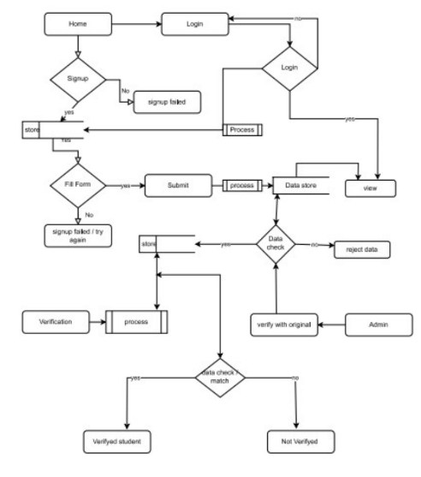
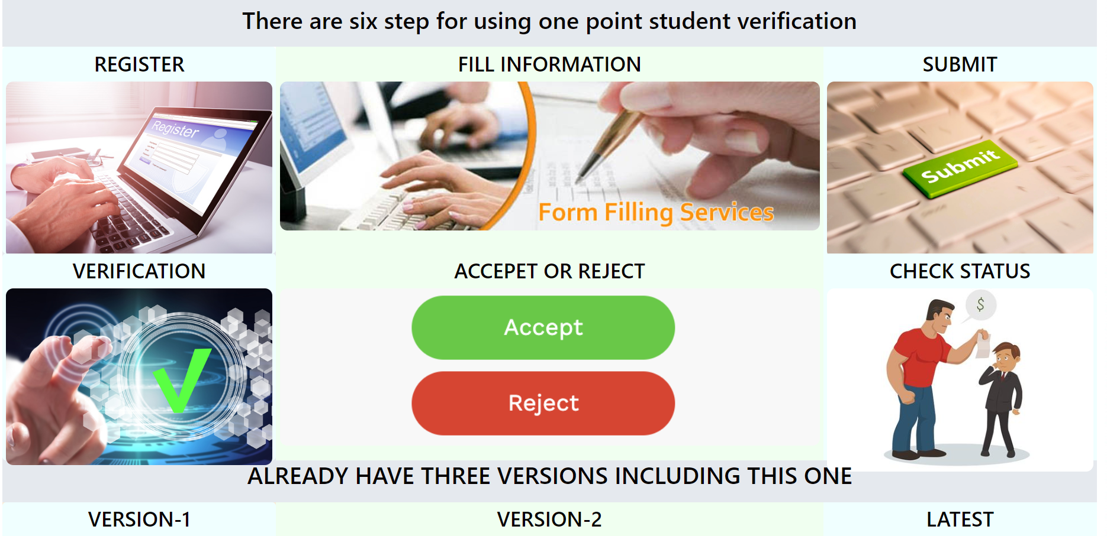
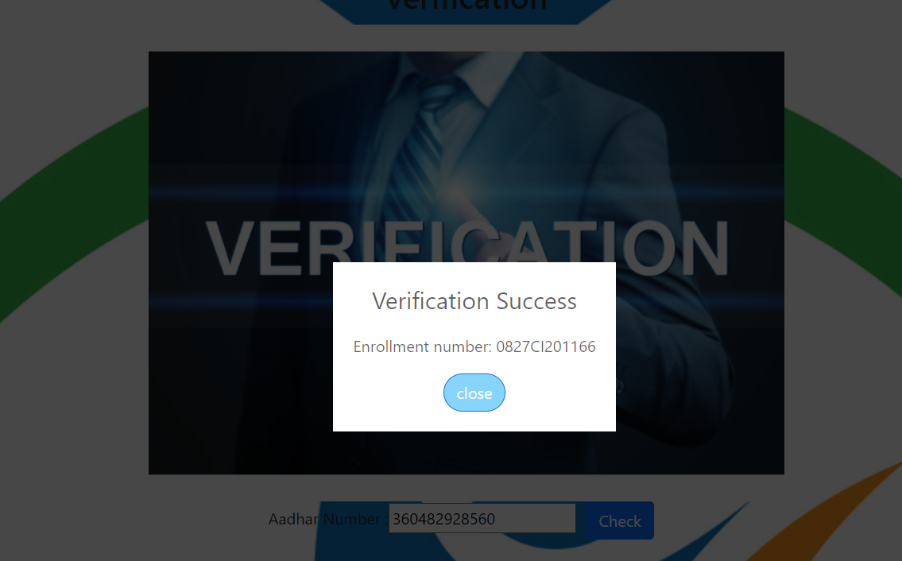
Acropolis Institute of Technology and Research
ONE POINT STUDENT VERIFICATION
AMAN PATEL . BHOMIK GAHLOT . CHANDRANSH SINGH CHOUHAN . AASTHA SHARMA
INTRODUCTION
METHOD
RESULT
Conclusion
Our world has been radically transformed by digital technology-smart phones, tablets, and web-enabled devices have transformed our daily lives and the way we communicate. Students are the most important groups who contribute to the nation. Greater and more detailed information of a student within a digital information system encompasses transformation to a digital world. Gathering the student information digitally is very useful for analyzing the student’s educational details and their personal details. There are no hard and fast rules when it comes to gathering information on the internet. The educational details of the students are collected from each student and recorded in the database. When Admin gets a large number of students data they have the advantage to verify the students information. One point student verification gathers the students information and provides It at the time it needed. These information which is provided by the student is then collected in the database and when the user login and provide a unique id of the student , it will provide the status of the student that the student is verified or not in One point student verification.
The working model of the project is shown below using data flow diagram in fig 1:
Tools and technology :
• Node.js : It is used to built the backend of the project.
• React js : it is a GUI used to build to build frontend of the project.
• Express .js : It is also used to build server side of the project.
• Mongo DB: It is used to build database side of the project.
Libraries used :
Java script, react.js, Bootstrap.
Tools used : Vs code and many other application which is required to developed the project
.
Thus the entire educational details of the student is verified by one point student verification.
After the information is verified now admin is free from the concern of verification of the student.
In this way it is beneficial for admin and student both.
The purpose of this project is to make an entire educational details of the student is verified by one point student verification.
After the information is verified now admin is free from the concern of verification of the student. In this way it is beneficial for admin and student both.
REFERENCE
[1] N. Sudhakar Reddy, MVSumanth, S. Suresh Babu, "The Counterpart Approach to Attendance and
Feedback System uses Machine Learning Techniques", Journal of Emerging Technologies and
Innovative Research (JETIR), Volume 5, Issue 12, Dec 2018.
[2] Dan Wang, Rong Fu, Zuying Luo, "Classroom Attendance Auto-management Based on Deep Learning",
Social Sciences Development, Humanities Education and Research, volume 123, ICESAME 2017.
[3] Akshara Jadhav, Akshay Jadhav, Tushar Ladhe, Krishna Yeolekar, "Automatic Travel System Using Face
Recognition", International Research Journal of Engineering and Technology (IRJET), Volume 4, Issue 1,
Jan 2017.
[4] B Prabhavathi, V Tanuja, V Madhu Viswanatham and M Rajashekhara Babu, "A clever system of
presence to see the face in the same way", IOP Conf. Series: Materials Science and Engineering 263,
2017.
OBJECTIVES
The main objective of this project one point student verification which help the organization to identify the student details. Verified information of the student will help the college and requiteing organization to verify that the given information by the student is correct or not. And student are verified or not to the institute.
CONTACT
Aman Patel 0827CS213D03
amanpatelcs21@acropolis.in
Aastha sharma 0827CS213D01
aasthasharmacs21@acropolis.in
Bhomik gahlot 0827CS213D08
bhomikgahlotcs21@acropolis.in
Chandransh chouhan 0827CS201062
chandranshchouhan20665@a cropolis.in

